Slide 1
https://codeburst.io/algorithms-i-searching-and-sorting-algorithms-56497dbaef20

Slide 2
CSS143 Computer Programming (II)

Slide 3
Homework 1 Review

Slide 4
Function vs class (encapsulation)
constructor
Class vs object
Reference vs copy
Shallow vs deep
Multiple class vs inheritance
Polymorphism

Slide 5
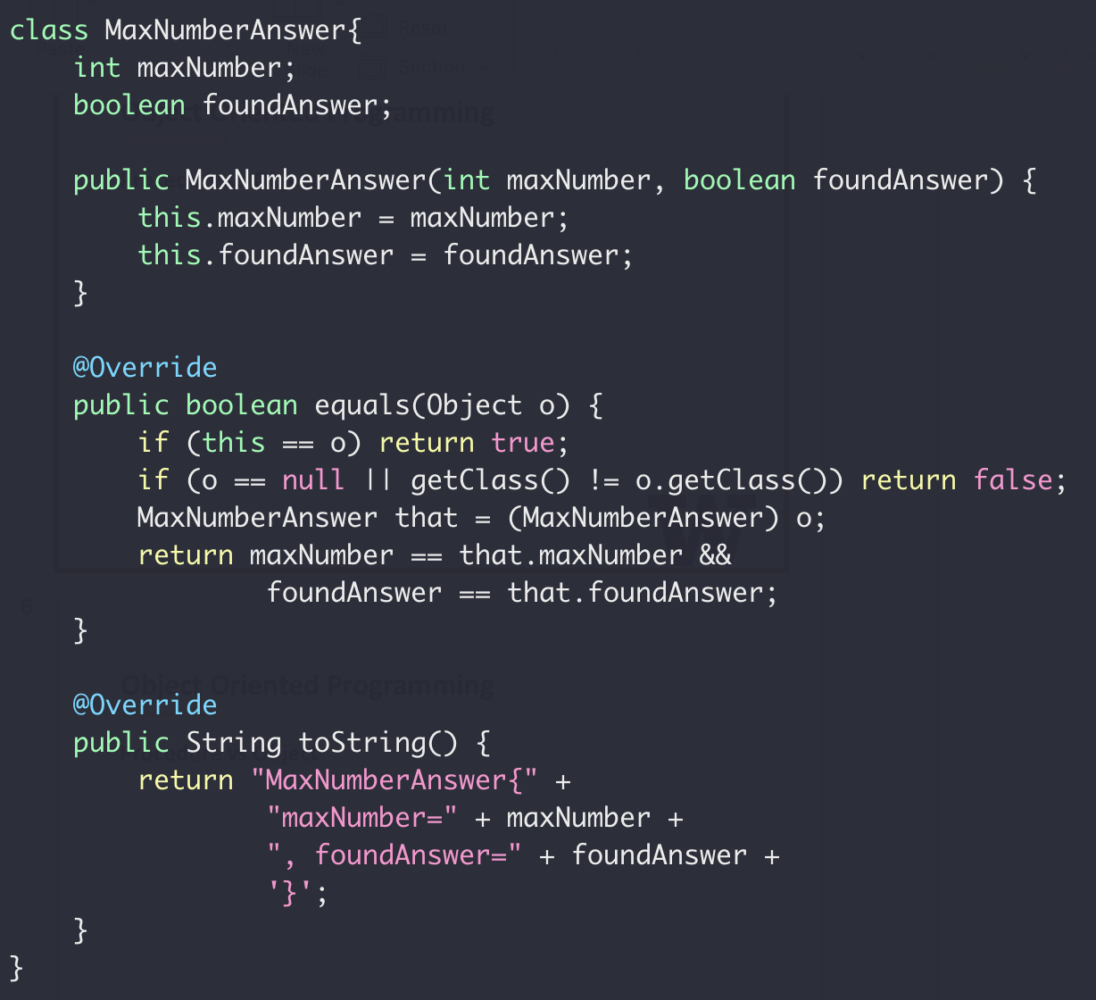
Object Oriented Programming
Find the maximum number in an array
Return value:
Max value
IsValid

Slide 6
Object Oriented Programming
Class
Variables
Variables
Methods
Methods
A class is a type like
int, float, boolean

Slide 7
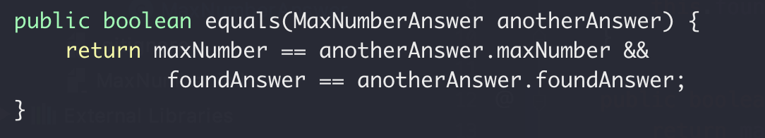
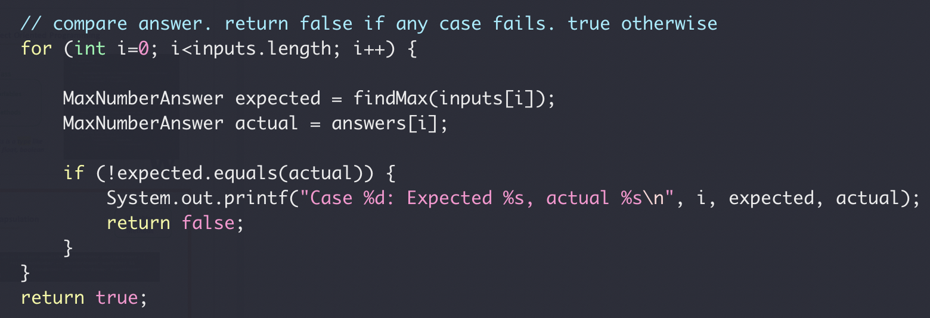
Encapsulation
Class
Variables
Methods
MaxNumberAnswer.equals(…)
testFindMax()

Slide 8
Class Exercise
Implement a class for cats
Member Variables:
Name
Gender
Age
Member Methods:
Speak
Play

Slide 9
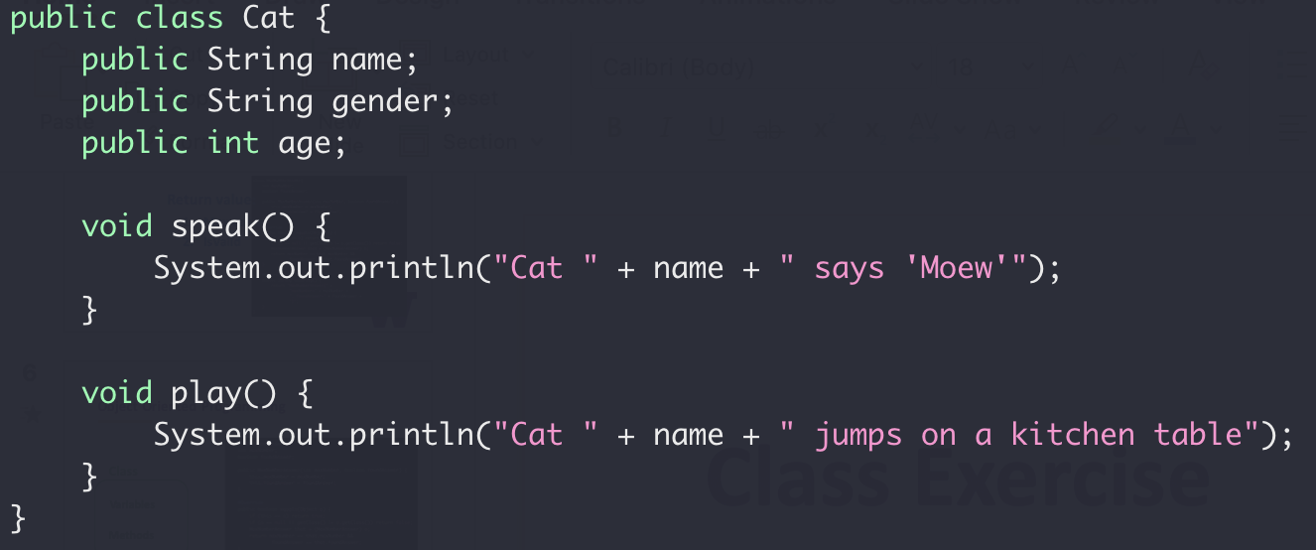
Class Exercise
Implement a class for cats

Slide 10
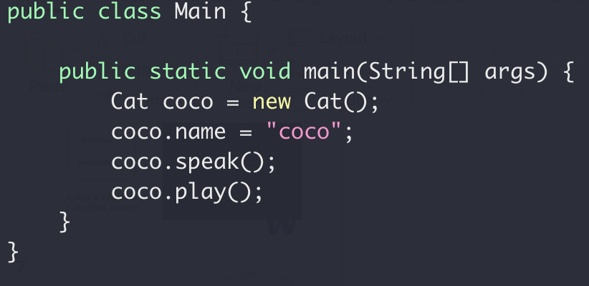
Class Exercise
Implement a class for cats

Slide 11
Class Exercise
Implement a class for cats

Slide 12
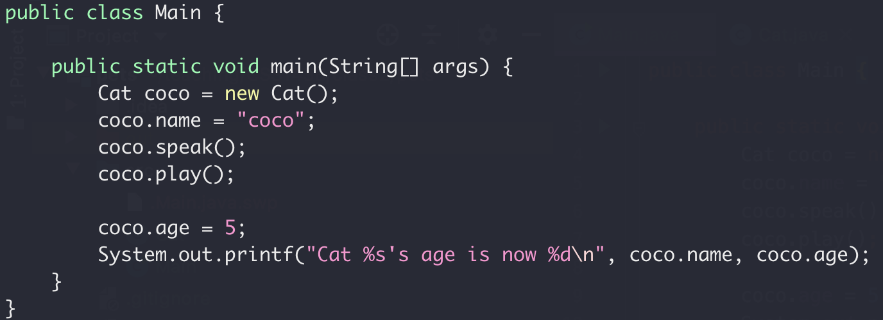
Encapsulation
Nop!
Your age is 5.
Me
☹

Slide 13
Encapsulation
Class
Variables
Variables
Access
public Methods
Methods
Setter/Getter
Read/Write
private Methods

Slide 14
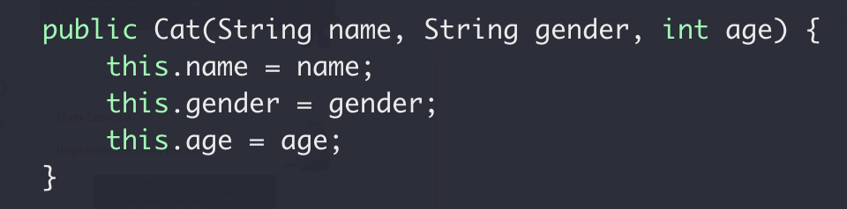
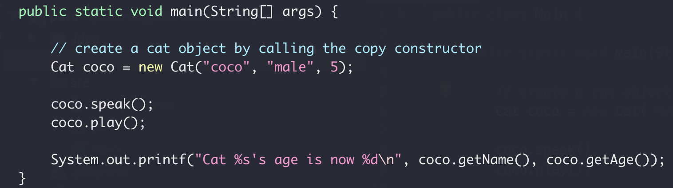
Class Exercise
Copy Constructor

Slide 15
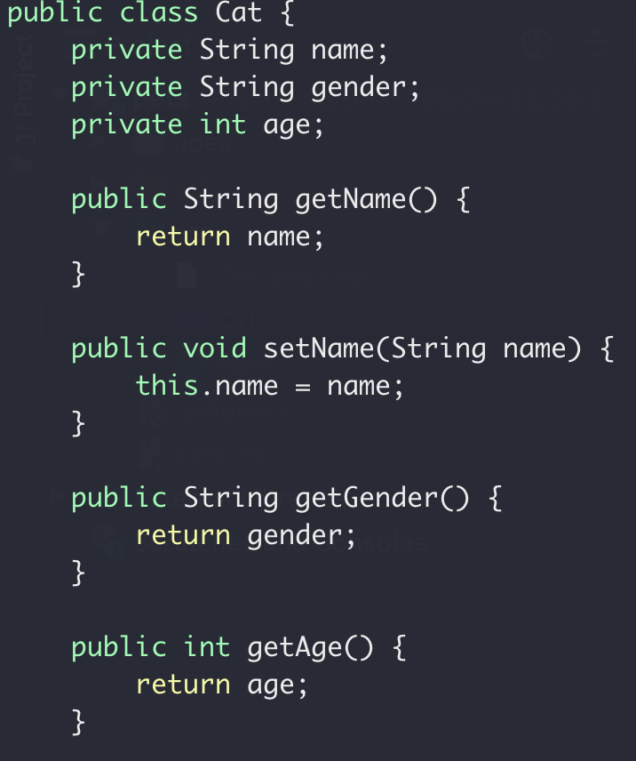
Class Exercise
Setter and Getter

Slide 16
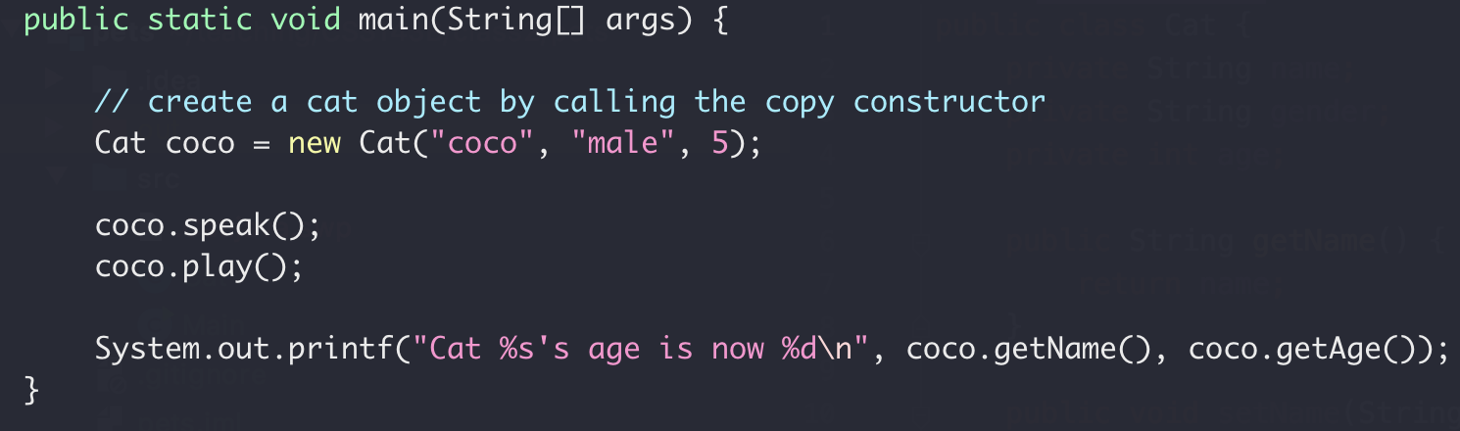
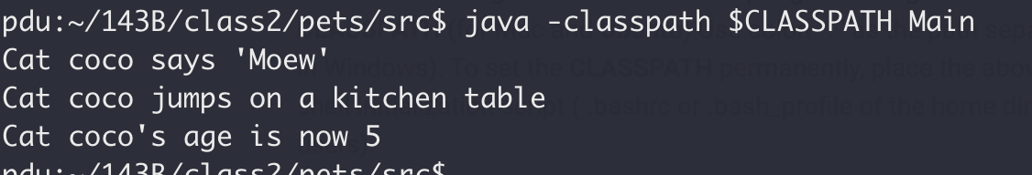
Class Exercise

Slide 17
Encapsulation Summary
Group properties (variables) and methods (that work on properties) into a single concept call “class”
Group properties (variables) and methods (that work on properties) into a single concept call “class”
Member variables should be private (not exposed to outside)
Member variables should be private (not exposed to outside)
What’s the default access level? Public or private?
Constructor to set/initialize members when creating object
Constructor to set/initialize members when creating object
Setter/getter for member properties access

Slide 18
Class Exercise
Implement a class for dogs
Member Variables:
Name
Gender
Age
Member Methods:
Speak
Play

Slide 19
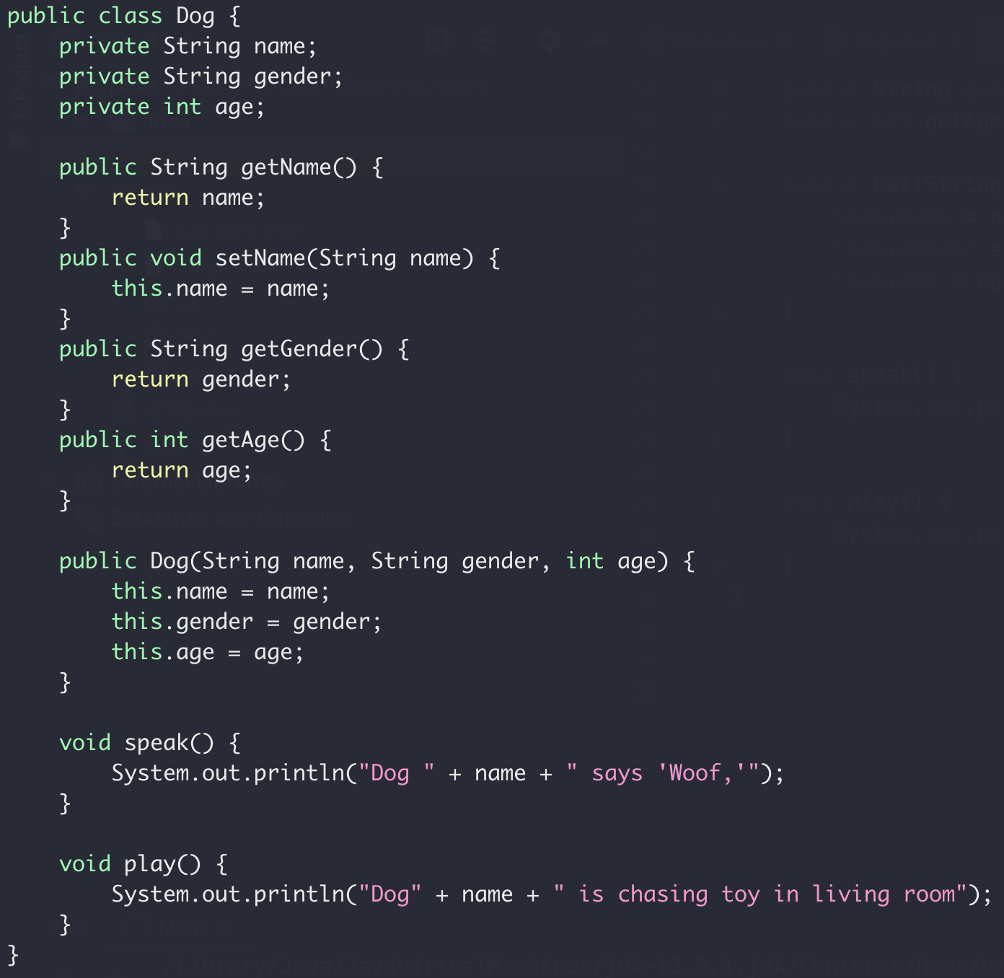
Class Exercise
Implement a class for dogs

Slide 20
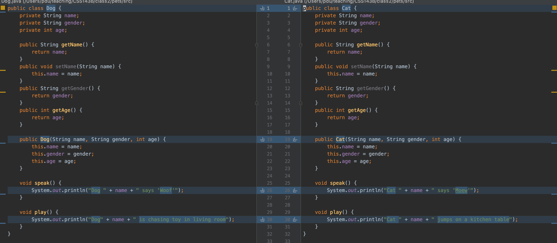
Class Exercise
Dog class vs Cat class

